Slide 1
Wonder Boys & Social Noise
Tyler Parker
Arkansas Tech University

Slide 2
How can analytics help with retention and recruitment of students through social media?

Slide 3
Get
Retain
Maintain
Notes:
Get
Retain
Maintain

Slide 4
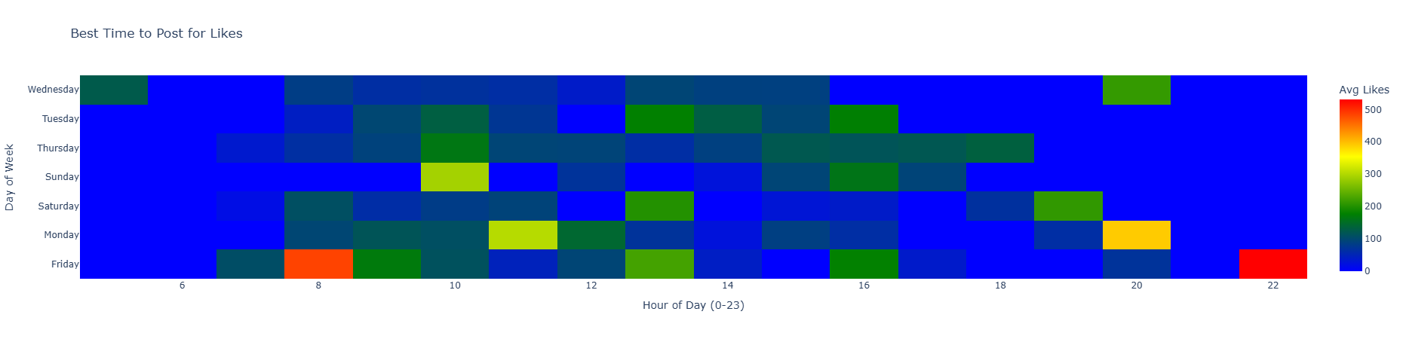

Slide 5
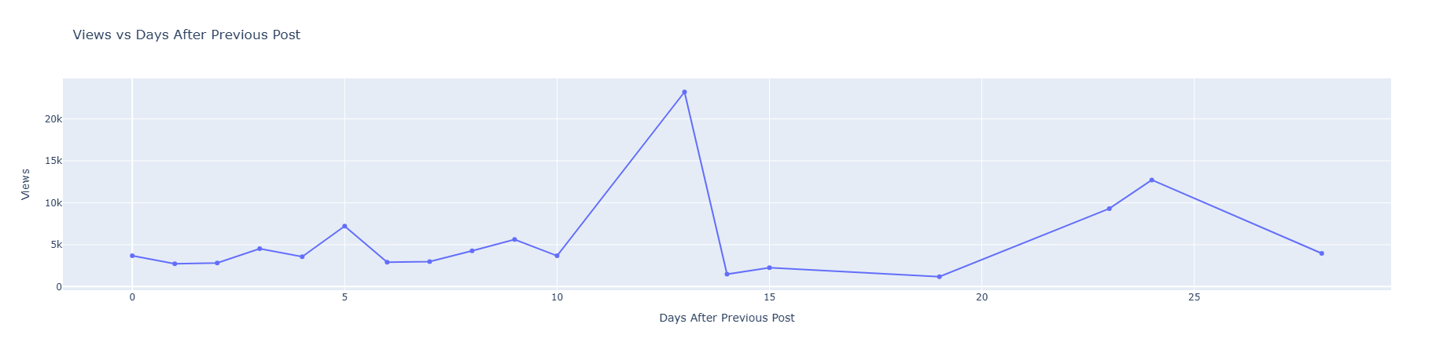

Slide 6
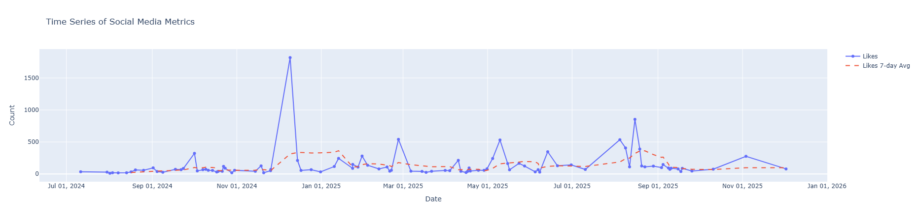

Slide 7
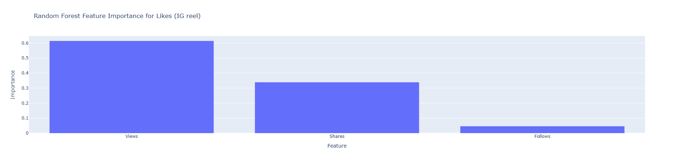
Feature Importance

Slide 8
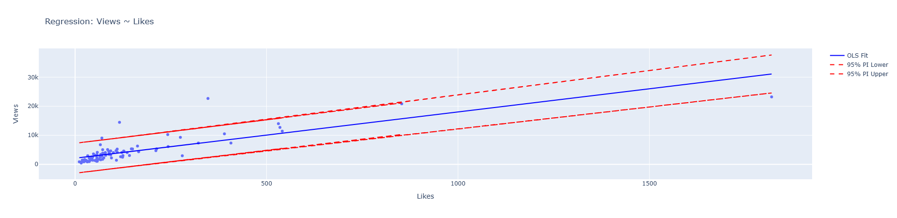
Regression

Slide 9
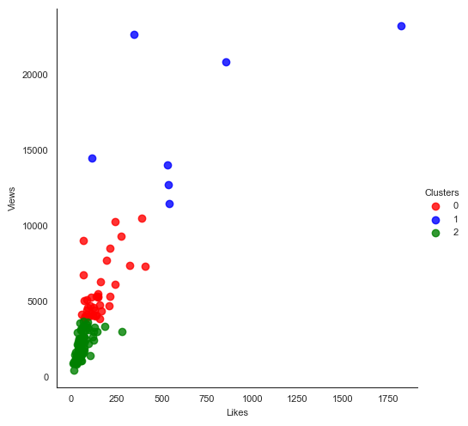
Notes:
Reel
cluster Likes Views
0 124.3125 4492.104167
1 323.666667 11132.11111
2 53.985294 1698.882353
3 1006.333333 22246.33333

Slide 10
Text Analysis
Sentiment -1:1 negative – positive wording
Subjectivity: 0:1 factual – opinionated

Slide 11
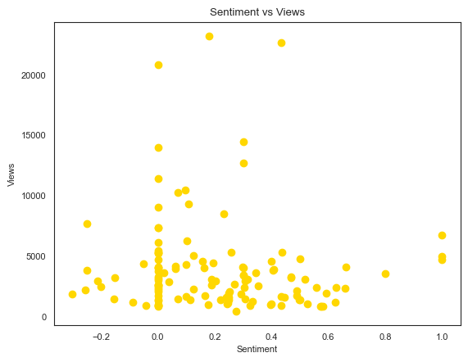

Slide 12
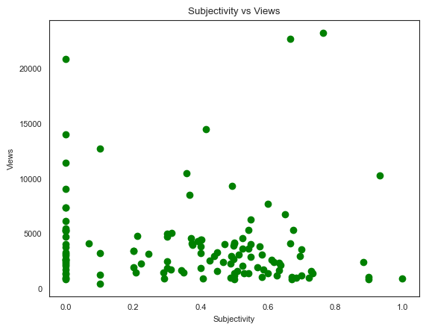

Slide 13
Findings
Keep descriptions short
Post on Fridays (8 am / 10 pm)
Keep a similar feel to other post that went viral
Push more views

Slide 14

Learn more!

